Slide 1
Day 4
Cardiac Arrest (Arrest Arrhythmias)
Technical Errors

Slide 2
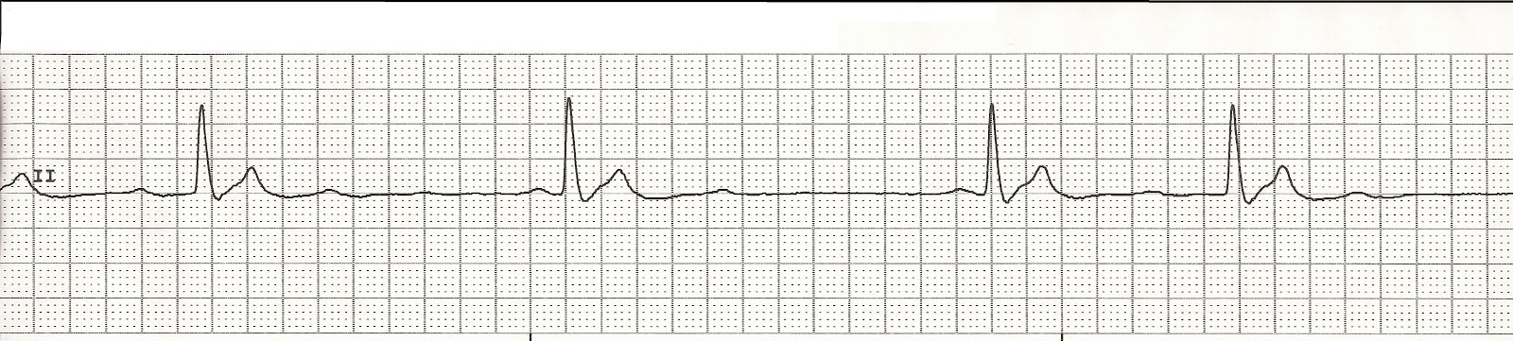
Pulses Electrical Activity

Slide 3
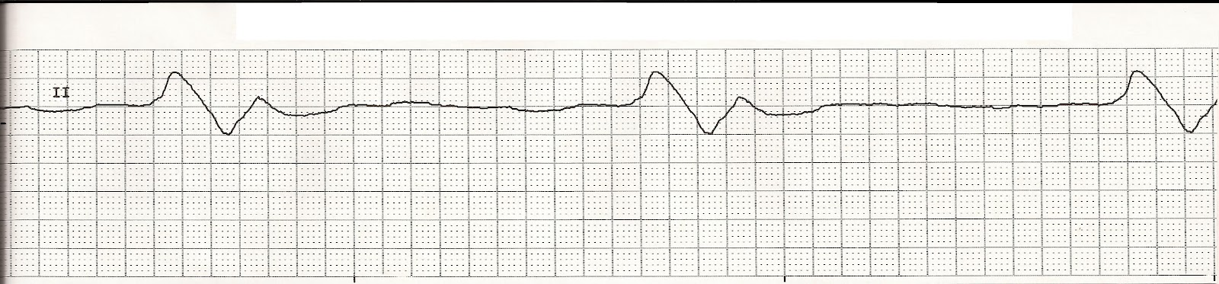
Agonal Rhythm

Slide 4
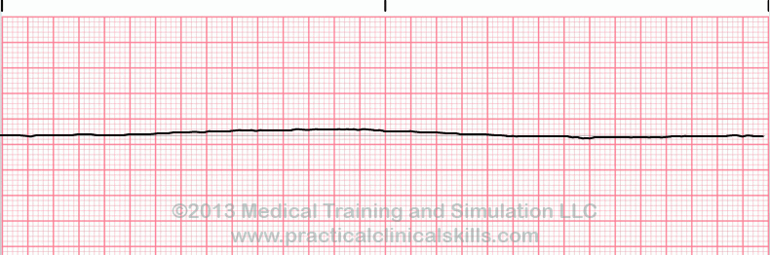
Asystole

Slide 5
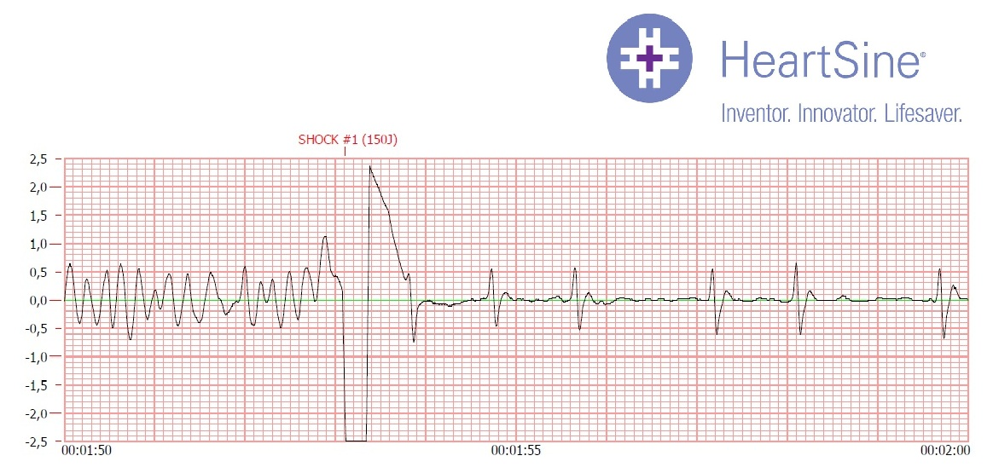
Strip with Shock

Slide 6
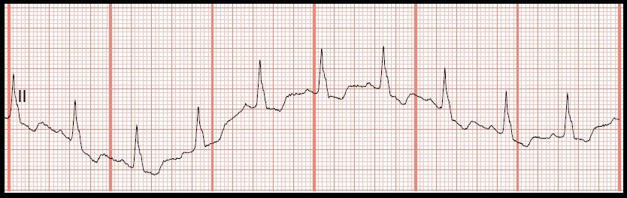
Wondering Baseline

Slide 7
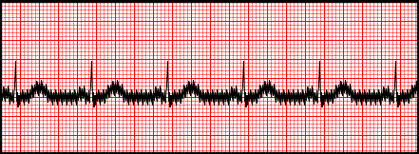
Artifact

Slide 8
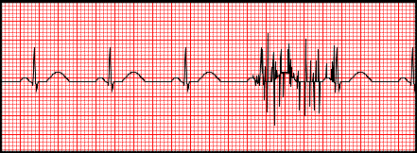
Muscle Trimmer

Slide 9
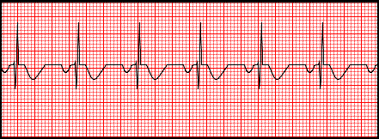
Reversed Leads

